Slide 1




F.L.O.W Flood Observation and warning
Mission Accepted Hackathon 2025
CHALLENGE 1: How can we use satellite
data to help protect
Canadian shorelines?

Slide 2

TEAM MEMBERS
AFIF ASAD AKASH MAITY ARYAN PANCHOLIA

Slide 3







Slide 4
AGENDA
1
The Problem Statement
2
Solutions Overview
6
3
Future Work
Prototype
5
4
Impact
Technical Architecture & Data Sources

Slide 5
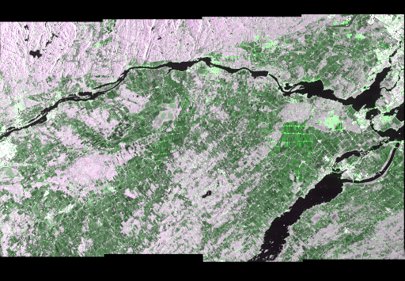
THE PROBLEM STATEMENT
THE PROBLEM STATEMENT

Slide 6
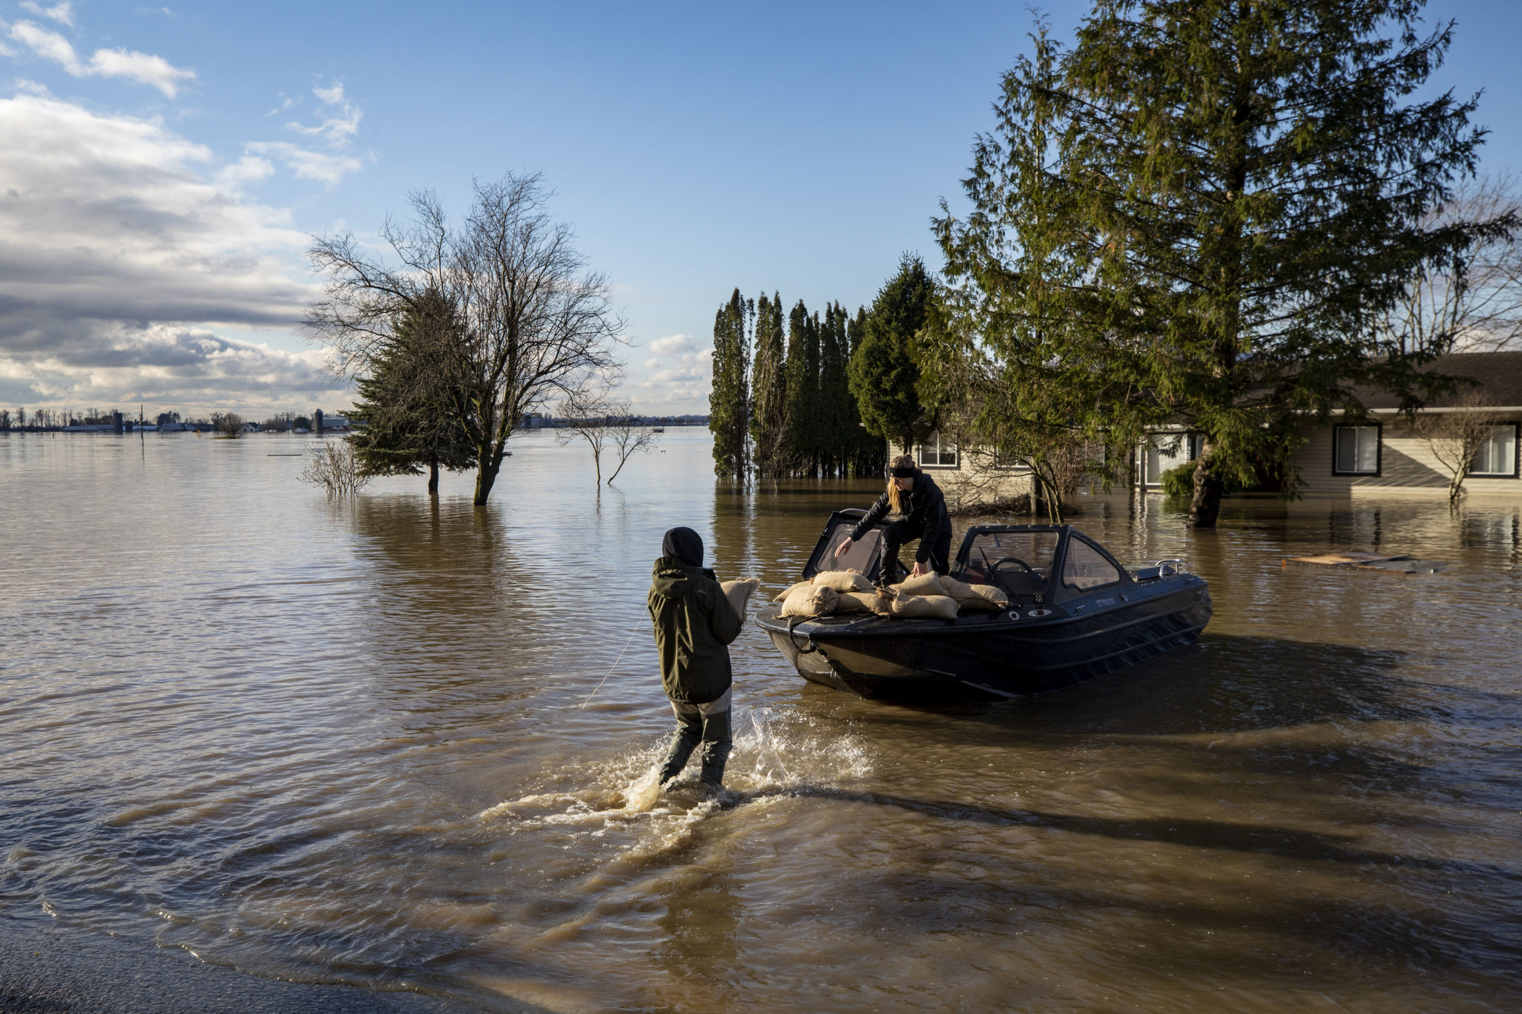
Record-Breaking Rainfall
On July 21, 2023, Halifax experienced unprecedented rainfall, with 250mm falling within a mere 24 hours, leading to catastrophic flooding.
Significant Economic Impact
The flooding resulted in over $200 million in damages, highlighting the urgent need for effective flood management strategies.
Human Cost
Tragically, the flooding claimed four lives, underscoring the critical importance of timely emergency responses and effective prediction systems.

Slide 7
OUR Solution
HOW IT WORKS:
AI-based system for predicting flood spread across Halifax.
Combines satellite, weather, and terrain data.
Delivers real-time flood maps and “What-if” rainfall scenarios.

Slide 8
The goal
Support responders, planners, and residents with actionable predictions.

Slide 9
OUR Prototype

Slide 10
Technical Architecture
Processes Canadian satellite data to predict flood paths in Halifax.
Hybrid AI/ML Model
Convolutional Neural Network (CNN) + Random Forest

Slide 11
Data Source
Satellite and Data Sources
RADARSAT-2/RCM (CSA)
SCISAT (CSA)
CDEM (NRCan)
NOAA eTRaP (NOAA)
Data Source

Slide 12
Satellite and Data Sources
DATA Provided
RADARSAT-2/RCM (CSA)
SCISAT (CSA)
CDEM (NRCan)
NOAA eTRaP (NOAA)
5-50m SAR Imagery ((4-hr revisit)
Atmospheric Moisture Profiles
1m LiDAR Elevation Data
Rainfall Forecasts (0-24hrs)
Data Source

Slide 13
Data Source
Satellite and Data Sources
DATA Provided
Purpose in Model
RADARSAT-2/RCM (CSA)
SCISAT (CSA)
CDEM (NRCan)
NOAA eTRaP (NOAA)
5-50m SAR Imagery ((4-hr revisit)
Atmospheric Moisture Profiles
1m LiDAR Elevation Data
Rainfall Forecasts (0-24hrs)
Primary Flood Detection via water edge mapping
Adjusts model to rainfall impact and pre-flood moisture
Models slope and flow direction for path prediction
Supplements with future rain data where needed

Slide 14
IMPACT AND FUTURE WORK

Slide 15
THANK YOU!!!

Slide 16
Resources:
Where could it flood ?
HRM Flood Map
Canada Flood Map Inventory
Earth Observation Data Management System (EODMS)
MDA
CSA
ChatGPT
Grok
Loveable

